Slide 1


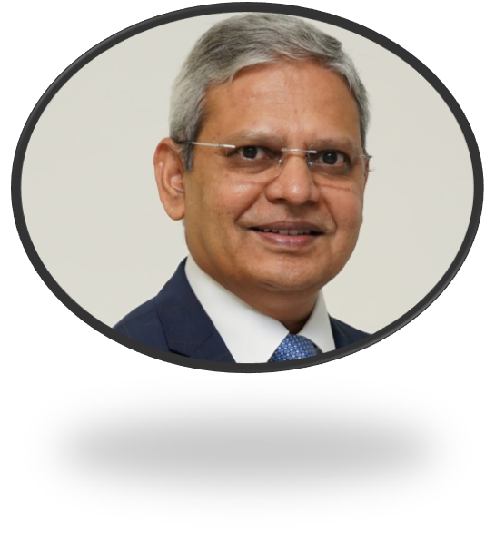
Speaker Introduction
Topic: Recent Global Developments in IPC Policies and Procedures
Dr Ranga Reddy Burri, a Key Opinion Leader and a strong policy advocate in IPC and AMR. Dr. Burri is the President of the Infection Control Academy of India (IFCAI) and Program Director of the Postgraduate level Diploma in Infection Prevention and Control (DIPC), one of the first formal academic programs of its kind in Asia.
He has been instrumental in advancing IPC & AMS policy, education, capacity building, and policy advocacy across India, Africa, and other regions of the Global South. Through his leadership, IFCAI has trained thousends of healthcare professionals and established strong collaborations with international organizations including WHO, ICAN, ReACT, ICARS and others.
Dr Ranga Reddy Burri
President- Infection Control Academy of India
Honorary Professor – University of Hyderabad
PRESENTATION

